Slide 1

Note: The data and information in this document is reflective of a hypothetical situation and client. This document is to be used for KPMG Virtual Internship purposes only.
Sprocket Central Pty Ltd
Data analytics approach
Julian Shalash

Slide 2
Note: The data and information in this document is reflective of a hypothetical situation and client. This document is to be used for KPMG Virtual Internship purposes only.
Agenda
Introduction
Data Exploration
Model Development
Interpretation

Slide 3
Introduction
Identify and Recommended top 1000 customers to target from dataset .
Content of data analysis:
New and old customer age distribution
Bike related purchased over last 3 years based on gender
Job industry contributing the max profit and bike related sales
Wealth segment by age category
RFM_Value with customer level
Cars number based on state
The problems that we Discuss is about:
The marketing department company is looking to boost business sales by analyzing provided datasets by using 3 datasets provided the goal to analyze and recommended customers that the company should target to drive higher value for the company.

Slide 4
Data Exploration
Sheet name | column name | Data quality
transaction | online_order | Null values
transaction | brand | Null values
transaction | product_line | Null values
transaction | product_class | Null values
transaction | standard_cost | Null values
transaction | product_first_sold_date | Null values + Relevancy
NewCustomerList | last_name | Null values
NewCustomerList | DOB | Null values
NewCustomerList | job_title | Null values
NewCustomerList | gender | consistency
NewCustomerList | job_industry_category | consistency
CustomerDemoghraphic | last_name | Null values
CustomerDemoghraphic | gender | consistency
CustomerDemoghraphic | DOB | Null values
CustomerDemoghraphic | DOB | consistency
CustomerDemoghraphic | job_title | Null values
CustomerDemoghraphic | job_industry_category | consistancy
CustomerDemoghraphic | tenure | Null values
CustomerDemoghraphic | deceased_indicator | consistency
CustomerDemoghraphic | default | Relevancy
Data quality assessment
Data quality issue
Place any supporting images, graphs, data or extra text here.

Slide 5
Data Exploration
Bike purchased based on gender over last 3 years.
The graphs shows females have purchase more bikes over last 3 years compared to males
We can say females have had 2.7% higher bike related purchased compared to men over last 3 years
Place any supporting images, graphs, data or extra text here.

Slide 6
Data Exploration
Tob job industry contributing to Max profit :
The top 3 industry bringing in the highest
Profit is : are : Manufacturing , Financial
Services and Health
We can notice most of the industry have returned
Less than 1,000,000.00 $ as profit

Slide 7
Data Exploration
Profit of wealth segment by age category:
The graphs shows Mass customer segment
Makes the highest profit compared to others
Mass customer age category of 50 are likely
bring more profit compared to other age category
This can mean there is a trend of buying
Power , as we have seen the buying power
increases over time till 50 then we can notice
decreases in buying power.

Slide 8
Data Exploration
Count of cars owned group by states:
The graphs shows the states could be
potential market opportunities for the company
NSW has the highest potential as the
number of people that have cars is almost
equal to people who don’t own cars so there
is opportunity to find value customer in this
state

Slide 9
Model Development
Customer classification – Targeting high- value customers :
Overall this are the high-value customer must be targeted:
Based on gender high-value customer will be female compared to male
Based on job industry the high – value customers will be in Manufacturing , Financial
Services and Health.
Most high-value customer will be in 50 age category
Most states have high- value customers are NSW,VIC

Slide 10
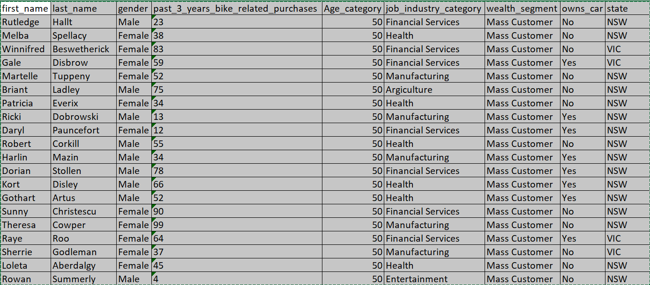
Interpretation
Brief table for high- value customers:
This table shows some of high- value customers
Place any supporting images, graphs, data or extra text here.

Slide 11
Thank you

